Slide 1
Perceiver & Perceiver IO Implementation and Experimental Analysis
Francesco Gigli · Corso Vignoli
Università degli Studi di Firenze | Course B031278 — Deep Learning

Slide 2
1
Introduction
2
Perceiver
3
Experiments: Perceiver
4
Perceiver IO
5
Experiments: Perceiver IO
6
Conclusion
F. Gigli C. Vignoli Perceiver & Perceiver IO

Slide 3
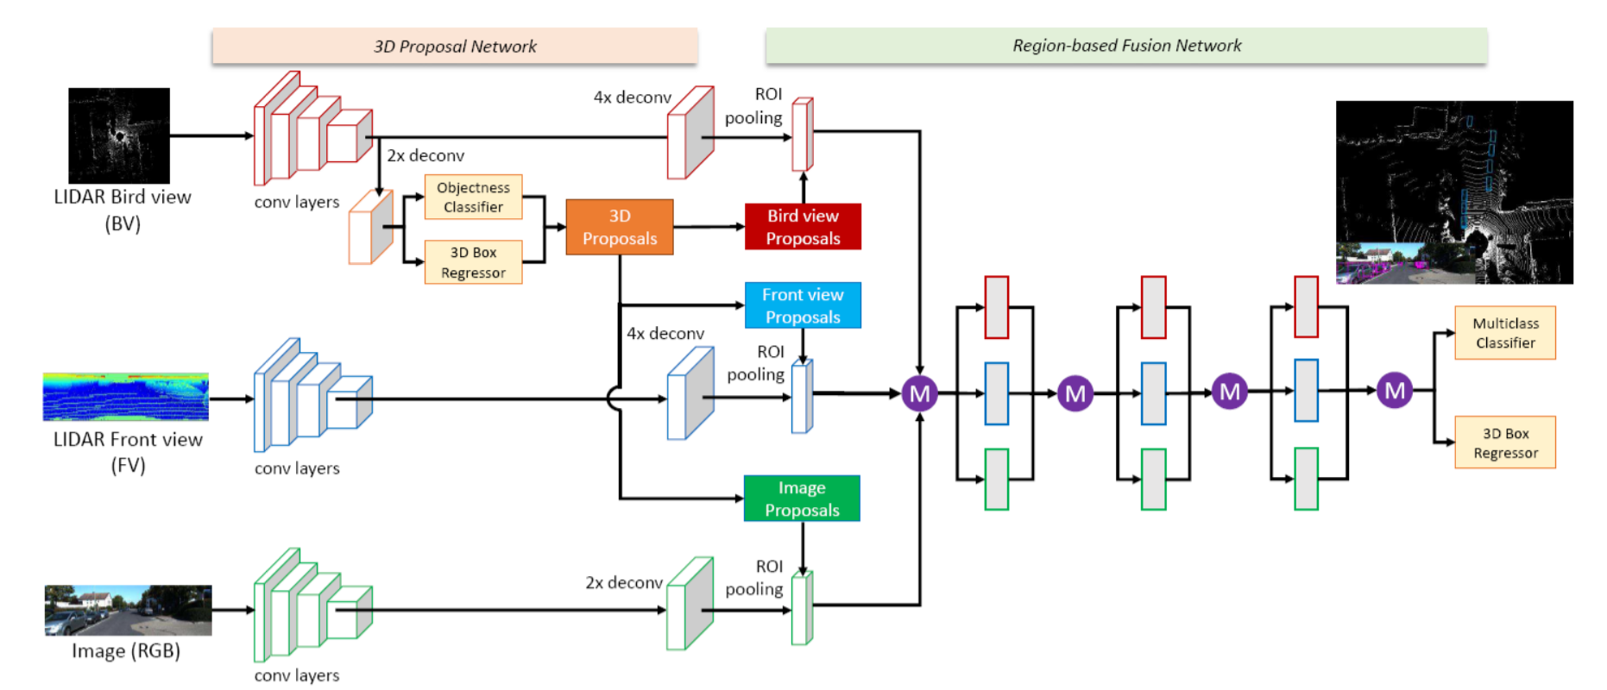
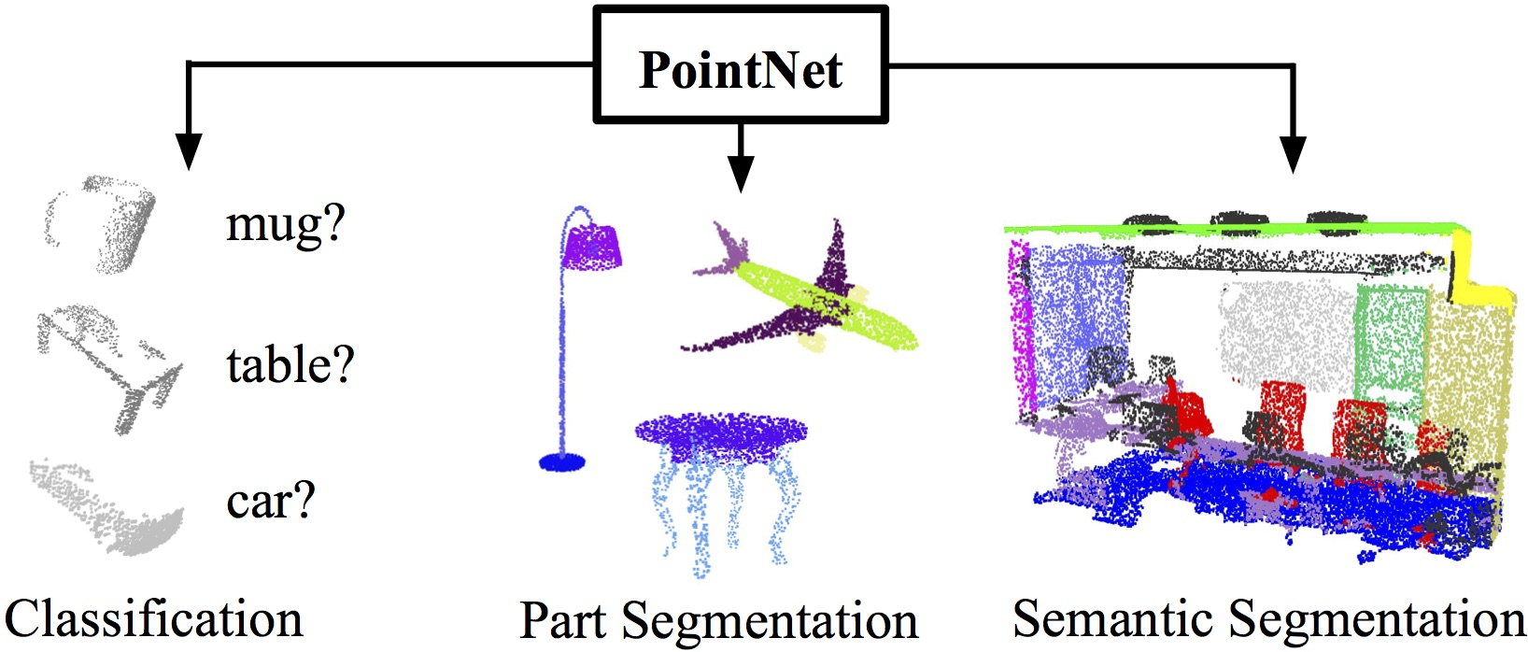
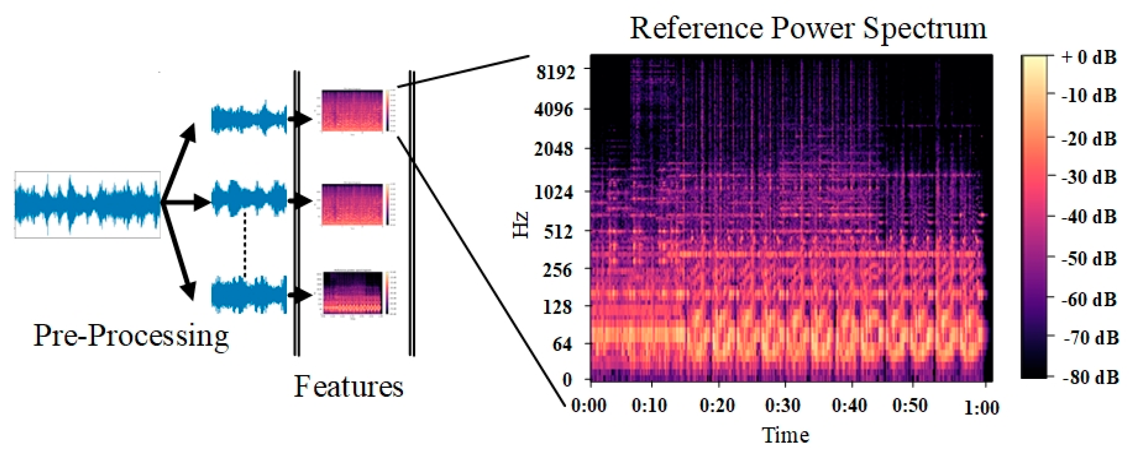
The Problem: Modality-Specific Architectures
One modality, one architecture
Images
→ CNNs
Text
→ Transformers
Audio
→ RNNs / 1D-CNN
Point Clouds
→ PointNet
Each data type is usually paired with a dedicated model and domain-specific assumptions about structure.
Can one architecture handle arbitrary inputs?
F. Gigli C. Vignoli Perceiver & Perceiver IO

Slide 4
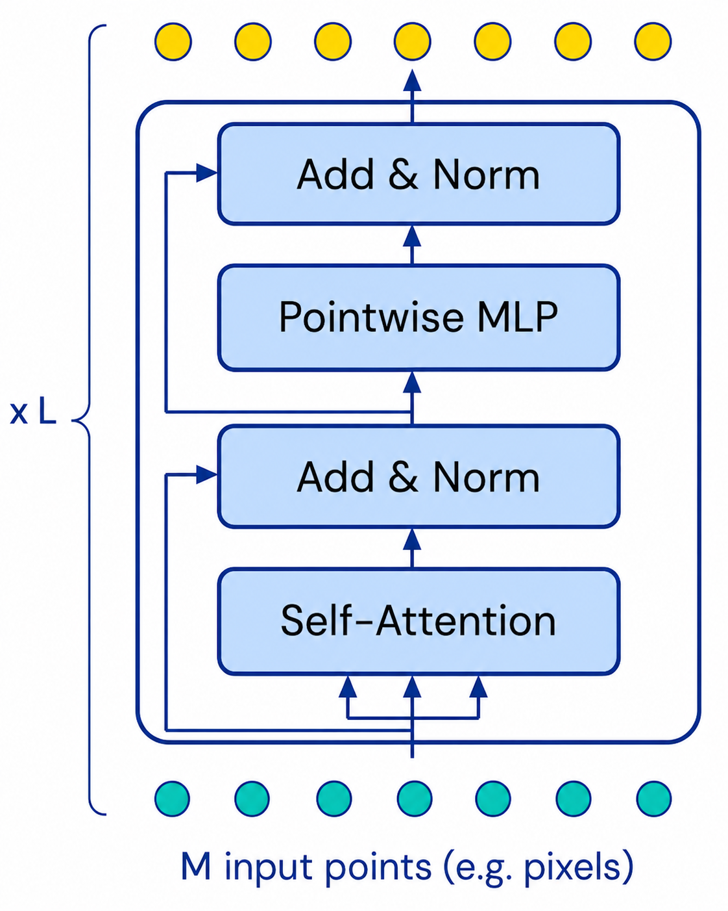
The Problem: Scaling bottleneck
A Transformer layer contains self-attention and a pointwise MLP.
Self-attention: compares all token pairs → cost $O$($M^{2}·L$)
Pointwise MLP: processes each token independently → scales linearly with $O\left(M·L\right)$
Input representation | M
16×16 image patches | 256
Raw 224×224 pixels | 50,176
!
The MLP scales linearly, but self-attention is the true bottleneck.
Raw pixels make standard attention impractical.
Can one architecture handle arbitrary inputs without quadratic cost?
F. Gigli C. Vignoli Perceiver & Perceiver IO

Slide 5
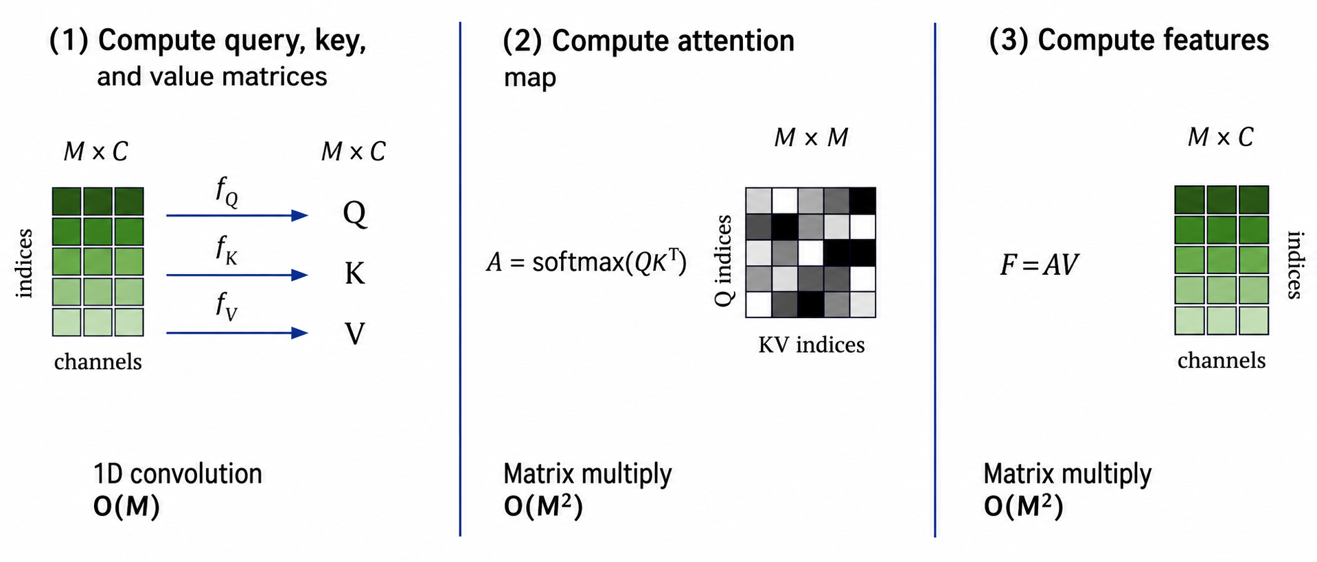
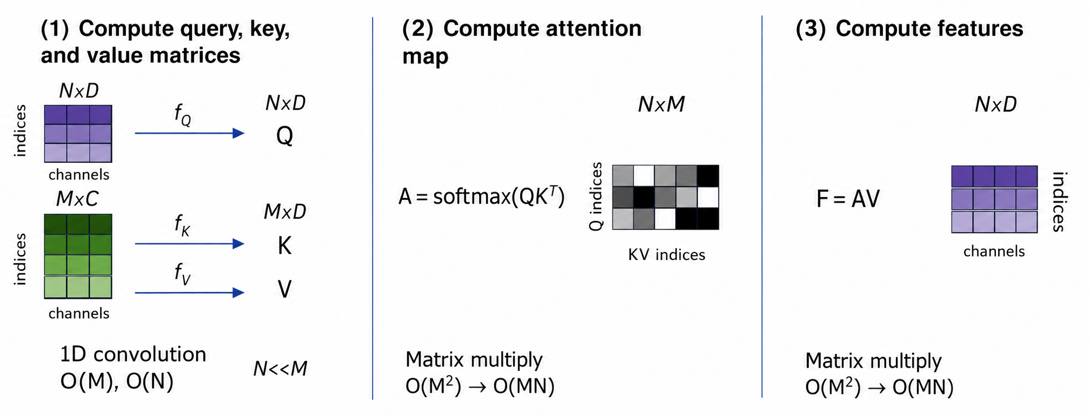
The Perceiver Solution
Standard self-attention
Perceiver cross-attention
O(M)
O(M²)
O(M²)
N(N) + O(M)
O(MN)
O(MN)
Self-attention: O(M²) → Cross-attention: O(MN)
F. Gigli C. Vignoli Perceiver & Perceiver IO

Slide 6
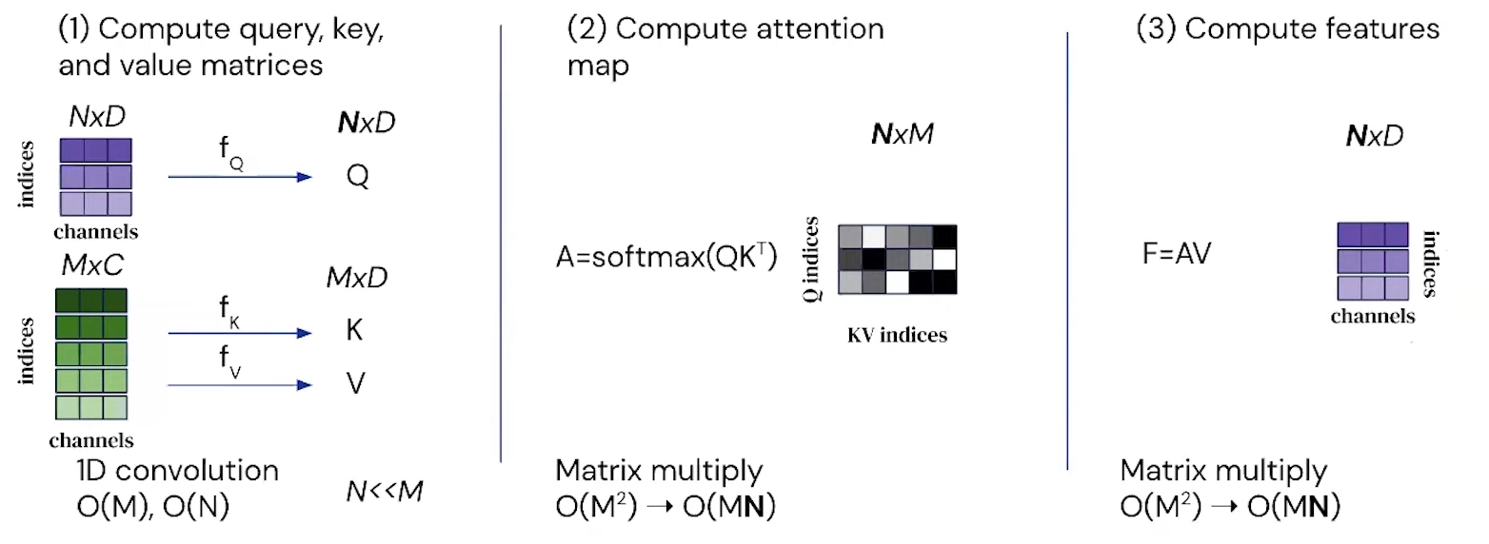
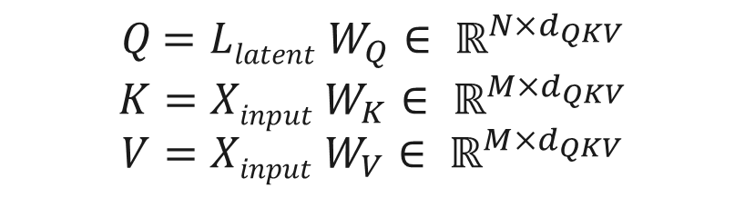
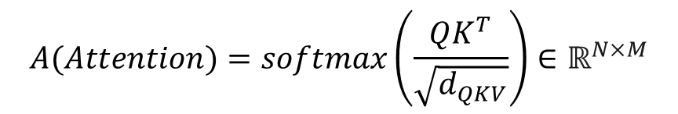

Cross-Attention
$Q$ $=Llatent W_{Q}∈ ℝ^{N×d_{QKV}}$
$$K=Xinput W_{K}∈ ℝ^{M×d_{QKV}}$$
$$V=Xinput W_{V}∈ ℝ^{M×d_{QKV}}$$
$$A(Attention)=softmax\left(\frac{QK^{T}}{\sqrt{d_{QKV}}}\right)∈ℝ^{N×M}$$
$F=CrossAttn(Q,K, V)$= $A∙V$ $∈$ $ℝ^{N×d_{QKV}}$
Cross-attention uses the latent array to read information from the input sequence. The output (F) is a compact latent representation that will be refined by the latent transformer.
F. Gigli C. Vignoli Perceiver & Perceiver IO

Slide 7
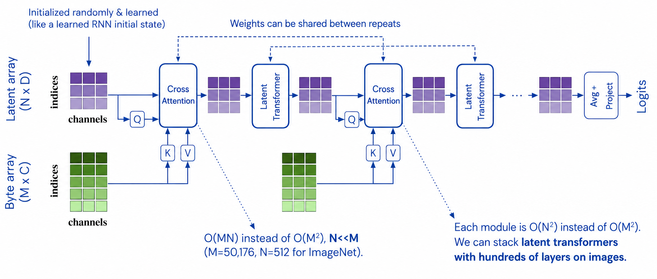
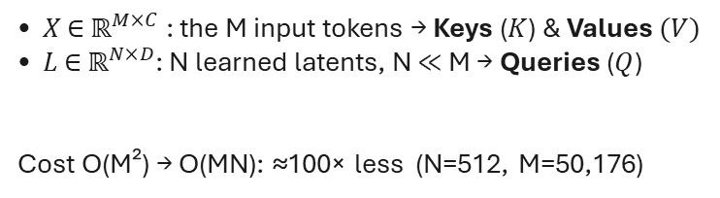
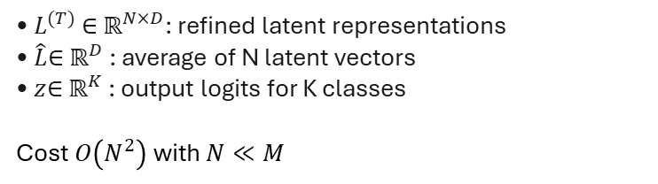
Perceiver Architecture
Encode and process
Latent core and output
• $X$ ∈ ${\text{ℝ}}^{M×C}$: the M input tokens → Keys ($K$) & Values $(V)$
• $L$ ∈ ${\text{ℝ}}^{N×D}$: N learned latents, N ≪ M → Queries ($Q$)
Cost O(M²) → O(MN): ≈100× less (N=512, M=50,176)
• $L^{(T)}$ ∈ ${\text{ℝ}}^{N×D}$: refined latent representations
• $\hat{L}$∈ ${\text{ℝ}}^{D}$: average of N latent vectors
• $z$∈ ${\text{ℝ}}^{K}$: output logits for K classes
Cost $O\left(N^{2}\right)$ with $N≪M$
F. Gigli C. Vignoli Perceiver & Perceiver IO

Slide 8
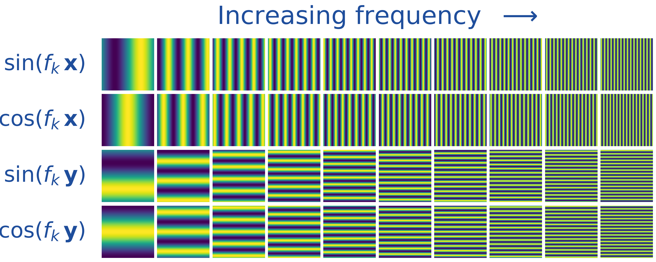
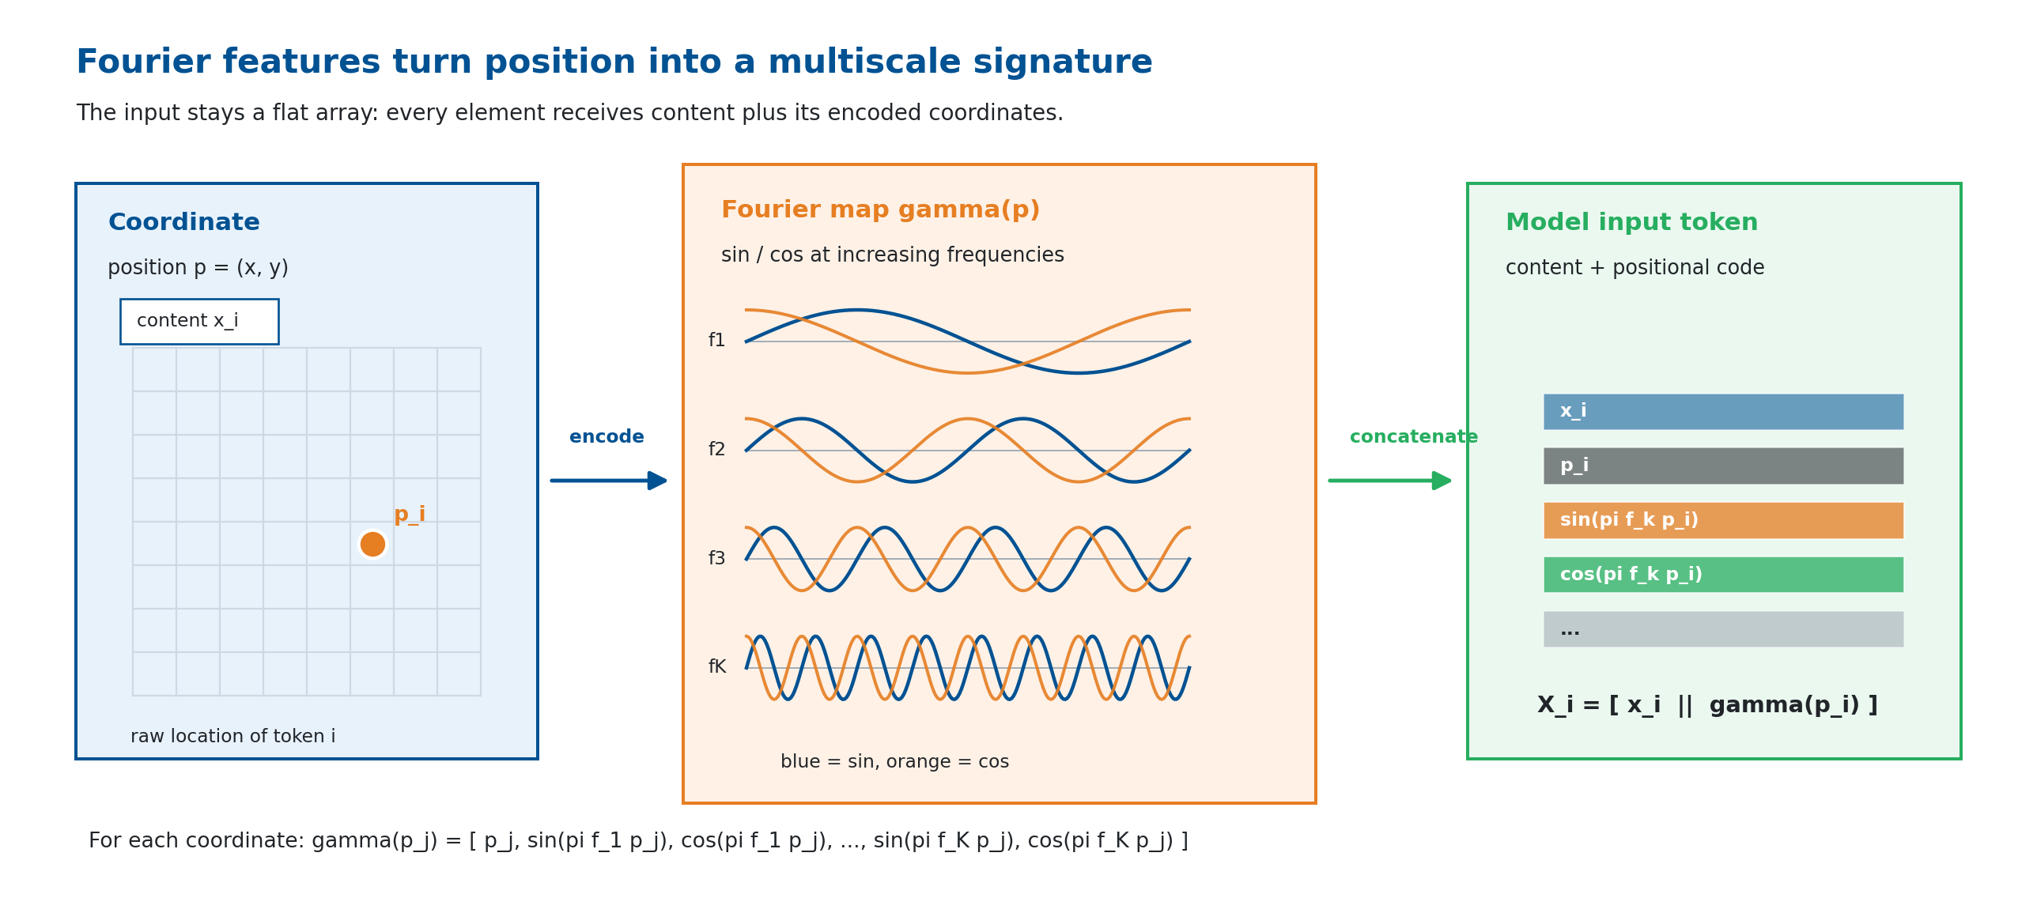
Fourier Positional Encoding
The Perceiver sees a flat array and attention is permutation-invariant, so position must be encoded into each input token.
$X_{i}=\left[x_{i}∥ γ\left(p_{i}\right)\right]$ — content ∥ Fourier position code
General recipe
Input seen by attention
• Domain coordinates: images (u, v), point clouds (x, y, z), text index t
• Sin/cos bands up to the Nyquist frequency — above it points alias and blur
• Sample the spectrum densely: more bands help (vs NeRF’s few)
• The array stays flat; each token is enriched before projection
• Position is concatenated to content, not added as in language
• Concatenation works better when content is dense (vision)
F. Gigli C. Vignoli Perceiver & Perceiver IO

Slide 9
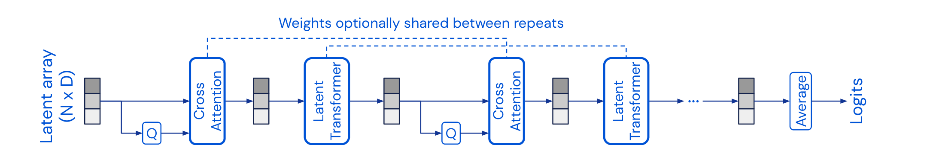
Latent Transformer & Weight Sharing
Once information is in the latent array, depth is spent by reusing the same processor on a compact state.
Weight sharing
Why it matters
• The same Latent Transformer block $B_{θ}$ is reused at every repeat, sharing parameters $θ$
• Unrolling depth behaves like an RNN over the latent state: $Z^{(t+1)}=B_{θ}(Z^{(t)})$
• Most useful in low-data regimes (e.g. ImageNet), where it curbs overfitting
• Iterative refinement without a new processor at each step
• Parameter count stays fixed as depth grows
• Computation stays in the compact N-slot latent space
• Optional repeated cross-attends re-read the input — powerful but heavy, no longer the default
F. Gigli C. Vignoli Perceiver & Perceiver IO

Slide 10
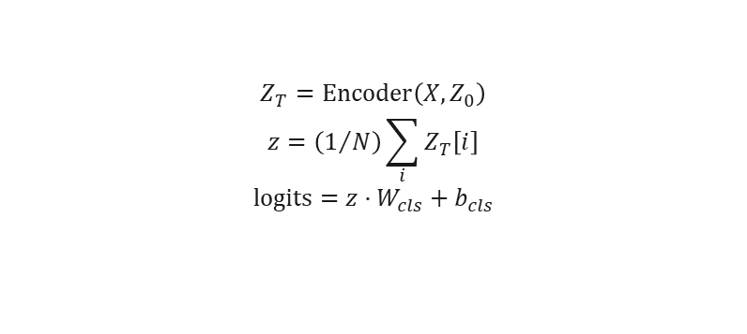
Original Perceiver Output: Pooling Classifier
Fixed-shape output head
Where FFN & sharing fit
$$Z_{T}=\text{Encoder}\left(X,Z_{0}\right)$$
$$z=\left(1/N\right)\sum_{i}{Z_{T}\left[i\right]}$$
$$\text{logits}=z·W_{cls}+b_{cls}$$
• Each latent block: pre-norm attention → residual → FFN → residual • FFN adds non-linearity after attention mixing • Weight sharing reuses the processor across iterations (first block has its own weights)
• Mean pooling collapses all latents to one vector • Predicts one global label per input • Ideal for classification, not dense structured outputs
Fixed-shape output
Pooling reduces the N latents to a single vector, so this head emits one global prediction per input.
F. Gigli C. Vignoli Perceiver & Perceiver IO

Slide 11
Computational Complexity Analysis
Model | Self-Attn | Cross-Attn | Total
Standard Transformer | $O(M^{2}d)$ | — | $O(M^{2}d·L)$
Perceiver | $O(N^{2}d)$ | $O(MNd)$ | $O((MN+N^{2}L)d)$
Symbols
Interpretation
$M$ — number of input elements $N$ — number of latent slots ($N≪M$) $L$ — number of latent processing layers $d$ — hidden channel dimension
• Full input is read once via cross-attention • Repeated self-attention stays in latent space • If N is fixed, depth is independent of input length • Concrete sizes are evaluated in the experiments
F. Gigli C. Vignoli Perceiver & Perceiver IO

Slide 12
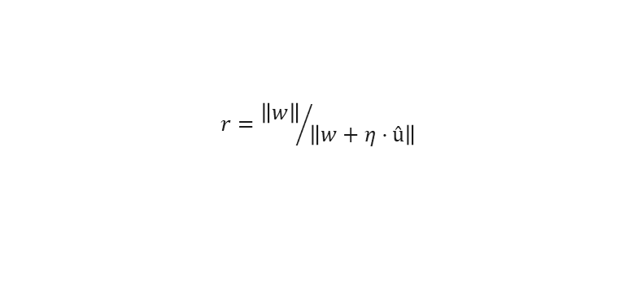
GELU Activation & LAMB Optimizer
GELU (Gaussian Error Linear Unit)
LAMB (Layer-wise Adaptive Moments)
$$\text{GELU}\left(x\right)=x·Φ\left(x\right)≈x·σ\left(1.702x\right)$$
$$r={\left\|w\right\|}/{\left\|w+η·û\right\|}$$
• Smooth activation used in Transformer architectures • Allows a small negative gradient to flow
• Per-layer trust ratio rescales updates • Stabilizes large-batch training
Why LAMB for Perceiver?
Optimizer | Large Batches | Layer-wise LR
Adam | Diverges | Global
LAMB | Stable | Per-layer trust
• Cross-attention bottleneck creates high-variance gradients • Standard Adam can destabilize with large batches • LAMB safely scales batch sizes up to 1024
F. Gigli C. Vignoli Perceiver & Perceiver IO

Slide 13
Implementation
Aspect | Paper implementation | Project code
Core model | Cross-attention into learned latents, latent self-attention, FFN, weight sharing | Same modules; weight sharing exposed as an ablation switch
Model scale | Large vision/language: up to 512×1024 latents, 201M-param IO | CIFAR-10 96×384; ModelNet40 / text 128×512
Data setting | ImageNet, ModelNet40, large language pretraining corpora | CIFAR-10, ModelNet40, WikiText-103 byte-MLM, GLUE fine-tuning
Training budget | Distributed accelerators, batches up to 512–1024 | Single-GPU, batches 32–128, LAMB retained
Practical additions | Minimal regularization in the reference setup | Dropout, logging, attention-map extraction, reproducible ablations
Architectural mechanism kept intact — the main differences are scale, data budget, and training resources.
F. Gigli C. Vignoli Perceiver & Perceiver IO

Slide 14
Implementation Differences from the Paper
Choice | Original paper (ImageNet) | This project
Input tokenization | Raw pixels, no patching (M = 50,176) | 2×2 patch embedding (CIFAR-10, M = 256)
Latent array N × D | 512 × 1024 | 96 × 384 (CIFAR-10); 128 × 512 (ModelNet40)
Cross-attend iterations T | 8 | 4 (CIFAR-10); 2 (ModelNet40)
Positional encoding | 2D Fourier, K = 64 bands/axis (258 dims) | 2D Fourier, 64 dims
Weight sharing | On by default (shared across T) | Exposed as an ablation switch (on/off)
Parameters | 30–200M+ | 3.35M (CIFAR-10) – 10M (IO)
Core mechanism preserved
Cross-attention bottleneck → weight-shared latent transformer → mean-pooling (Perceiver) / output-query decoder (IO); GELU MLP, pre-norm LayerNorm, Fourier frequencies linearly spaced to Nyquist.
F. Gigli C. Vignoli Perceiver & Perceiver IO

Slide 15
CIFAR-10: Experimental Setup
Goal — validate the Perceiver on flattened pixel patches, with no convolutional assumptions.
Hyperparameter | Value
Latent dim (N × D) | 96 × 384
Cross-attn stages | 4
Transformer blocks | 4 (shared)
Attention heads | 3
Patch size | 2 × 2
Dropout | 0.2
Optimizer | LAMB
Learning rate | 0.004
Batch size | 64
Epochs | 120
Total parameters | ∼3.35M
Ablation study plan
1. Impact of positional encoding 2. Weight sharing vs no sharing 3. Robustness to pixel permutation 4. Best classifier-head configuration
Data pipeline
• 32×32 RGB → 2×2 patches (M = 256 tokens, 12 channels) • 2D Fourier PE (64 features → input dim 76) • Augmentation: RandAugment (2 ops, magnitude 9)
F. Gigli C. Vignoli Perceiver & Perceiver IO

Slide 16
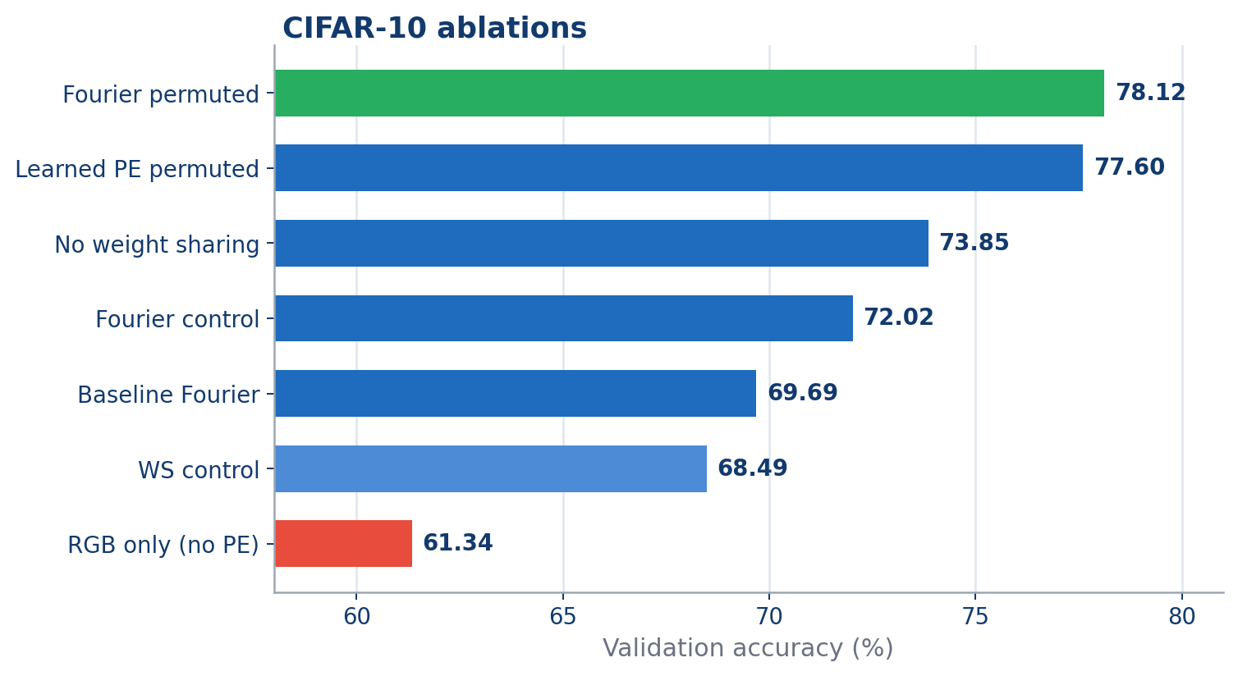
CIFAR-10: Ablation Accuracy
Best Perceiver run
78.12%
Measured comparisons
• No PE vs Fourier control: −10.68 pp • No sharing vs WS control: +5.36 pp • Fourier vs learned PE (fixed perm): +0.52 pp
Source: local experiment report — experiment_summary.csv
F. Gigli C. Vignoli Perceiver & Perceiver IO

Slide 17
CIFAR-10: Ablation Matrix
Run | PE | Perm. | Sharing | Params | Acc.
Fourier permuted | Fourier | yes | yes | 3.35M | 78.12%
Learned PE permuted | learned | yes | yes | 3.35M | 77.60%
No weight sharing | Fourier | no | no | 8.67M | 73.85%
Fourier control | Fourier | no | yes | 3.35M | 72.02%
Baseline Fourier | Fourier | no | yes | 3.35M | 69.69%
WS control | Fourier | no | yes | 3.35M | 68.49%
RGB only | none | no | yes | 3.30M | 61.34%
Position signal
Removing positional features costs 10.68 pp vs the Fourier control.
Capacity
Removing weight sharing adds 5.32M parameters for +5.36 pp.
Permutation
A fixed permutation keeps the task learnable when coordinates are provided.
F. Gigli C. Vignoli Perceiver & Perceiver IO

Slide 18
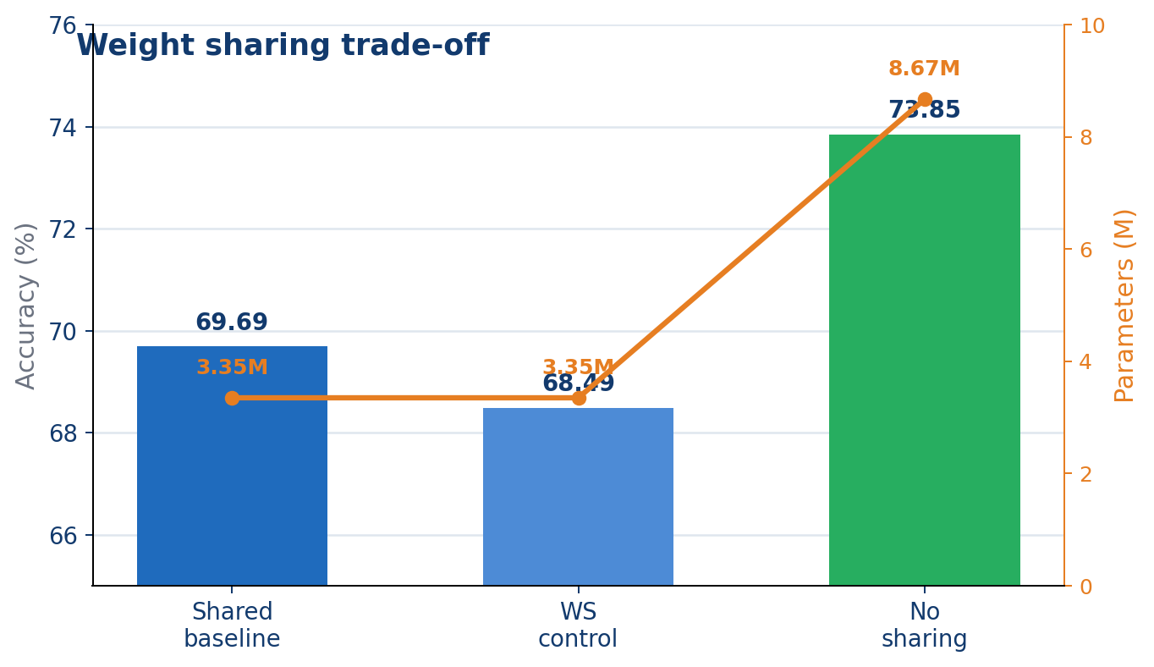
CIFAR-10: Weight Sharing Trade-off
Config | Params | Acc.
Shared baseline | 3.35M | 69.69%
WS control | 3.35M | 68.49%
No sharing | 8.67M | 73.85%
Trade-off
Dropping weight sharing trades parameters for accuracy: +5.36 pp at 2.59× the parameter count.
F. Gigli C. Vignoli Perceiver & Perceiver IO

Slide 19
CIFAR-10: Fixed-Permutation Test
Experiment — train & evaluate on pixels shuffled by a single fixed permutation σ (same σ throughout).
Configuration | Acc.
Fourier PE (natural order) | 69.69%
Fourier PE (permuted) | 78.12%
Learned PE (permuted) | 77.60%
Interpretation
• No built-in 2D bias — position is read only from the PE • With a fixed σ in train & test, it learns the layout from the Fourier features alone • Fourier PE stays slightly ahead of learned PE here • Read it as invariance, not a gain from shuffling — order carries no information, only the PE does
Permuted vs natural order: +8.43 pp • Fourier vs learned (permuted): +0.52 pp
Input order is not hard-coded — ordering information enters through positional features.
Note: the learned-PE run used a single cross-attention stage (vs 4); same parameter count.
F. Gigli C. Vignoli Perceiver & Perceiver IO

Slide 20
CIFAR-10: Best Perceiver Configuration
Configuration | Acc.
Fourier PE, permuted | 78.12%
Learned PE, permuted | 77.60%
No weight sharing | 73.85%
Baseline Fourier | 69.69%
Result pattern
• Fourier PE carries the spatial signal explicitly • Weight sharing is an efficiency–accuracy trade-off
F. Gigli C. Vignoli Perceiver & Perceiver IO

Slide 21
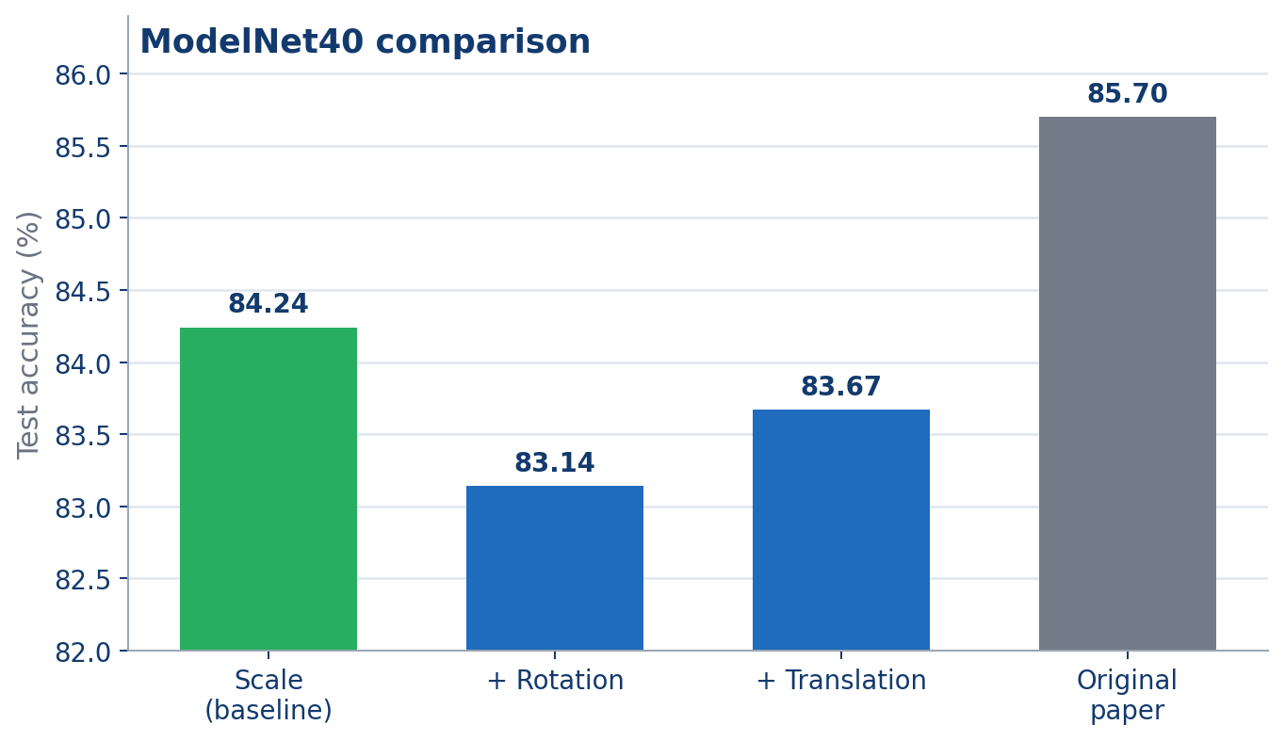
ModelNet40: Setup & Results
Hyperparameter | Value
Latent dim (N × D) | 128 × 512
Cross-attn stages | 2
Transformer blocks | 6 (shared)
Points per object | 2048
Optimizer | LAMB
Epochs | 200
Batch size | 128
Reproduction gap: 1.46 pp
F. Gigli C. Vignoli Perceiver & Perceiver IO

Slide 22
ModelNet40: Augmentation Effects
Measured deltas
Scale baseline: 84.24% + translation: −0.57 pp + rotation: −1.10 pp
Likely factors
• 3D Fourier PE already exposes coordinates • ModelNet40 objects are already centred • Extra variation did not help this run
Paper 85.70% · gap 1.46 pp from the scale baseline
F. Gigli C. Vignoli Perceiver & Perceiver IO

Slide 23
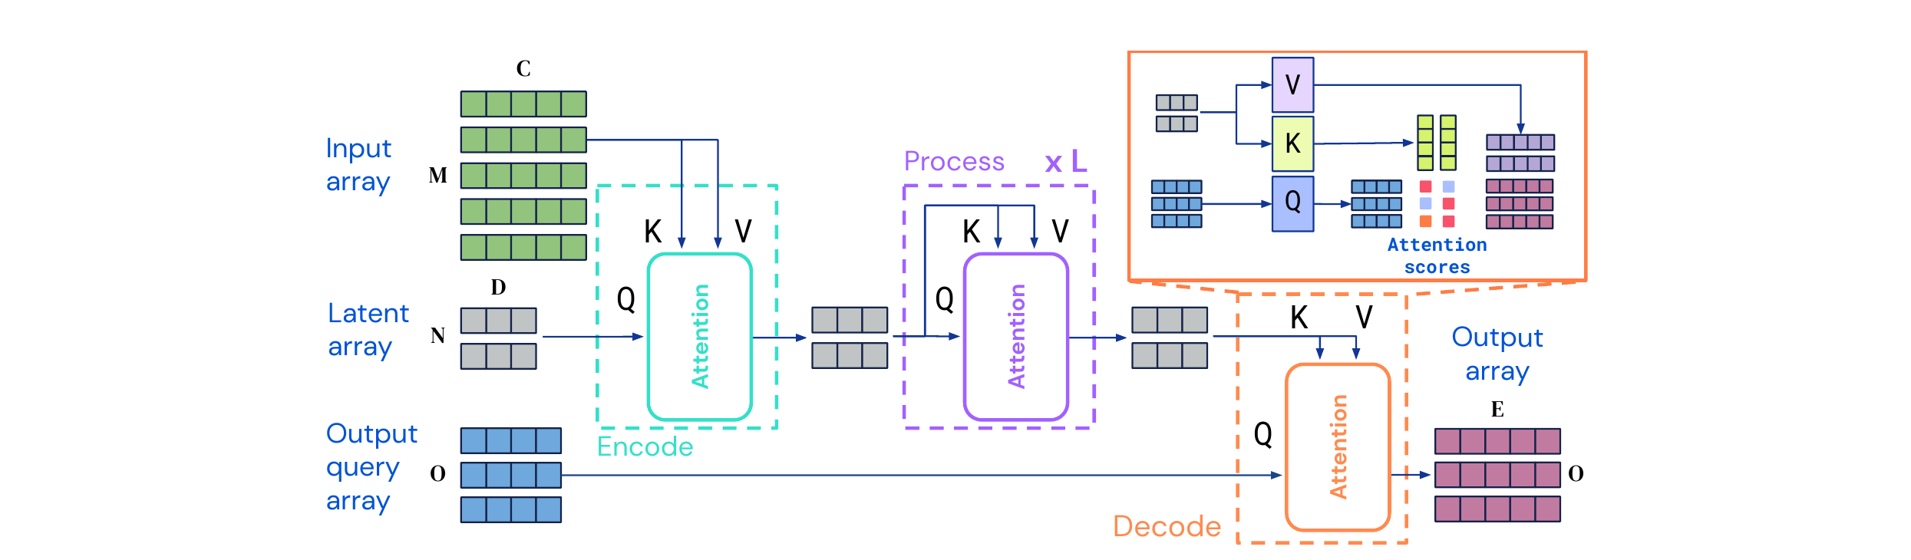
Perceiver IO: Structured Outputs
Perceiver IO — an extension of Perceiver (Jaegle et al., ICLR 2022)
Why it matters
• Original Perceiver emits one pooled global output • Perceiver IO produces a task-specific output shape • Same latent bottleneck, but a more general decoder
F. Gigli C. Vignoli Perceiver & Perceiver IO

Slide 24
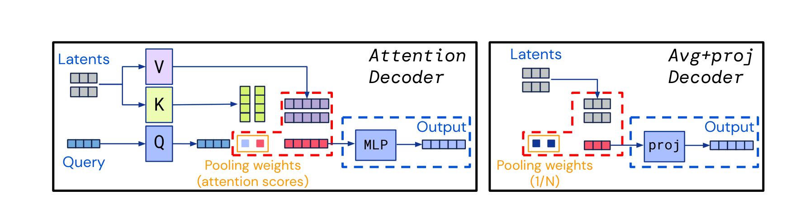
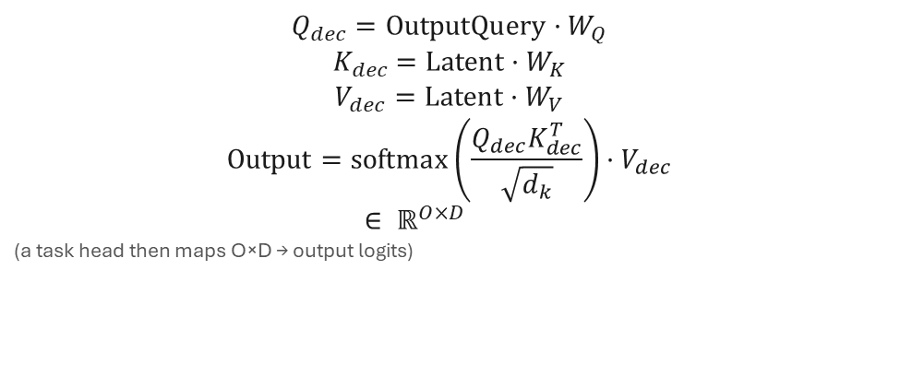
Perceiver IO Decoder with Output Queries
Decoder cross-attention (single layer)
Key points
$$Q_{dec}=\text{OutputQuery}·W_{Q}$$
$$K_{dec}=\text{Latent}·W_{K}$$
$$V_{dec}=\text{Latent}·W_{V}$$
$$\text{Output}=\text{softmax}\left(\frac{Q_{dec}K_{dec}^{T}}{\sqrt{d_{k}}}\right)·V_{dec}$$
$$∈ ℝ^{O×D}$$
(a task head then maps $O×D$ → output logits)
• Number of output queries O is task-dependent — independent of N and M • A single decoder cross-attention layer suffices • No self-attention among the outputs
F. Gigli C. Vignoli Perceiver & Perceiver IO

Slide 25
Output Query Design per Task
All heads read the same final latent array $Z^{(L)}∈{\text{ℝ}}^{N×D}$ via decoder cross-attention.
Classification
Dense outputs
Masked LM
$O=1$​
$O=H×W$​
$O=M$​
→ class logits
→ dense output
→ token logits
One learned query produces a single global prediction.
Output shape is controlled directly by the query array.
One query per byte position; the MLM loss is scored only at masked positions.
F. Gigli C. Vignoli Perceiver & Perceiver IO

Slide 26
CIFAR-10: Perceiver vs Perceiver IO
Decoder effect
• Output query is a learned aggregation, not fixed mean pooling • Decoder cross-attention attends selectively to relevant latents • Small gain on CIFAR-10, but enables MLM and dense outputs • Cost: ∼1.6× parameters (5.22M vs 3.35M)
Model | Acc. | ∆
Best Perceiver | 78.12% | —
Perceiver IO | 78.20% | +0.08 pp
F. Gigli C. Vignoli Perceiver & Perceiver IO

Slide 27
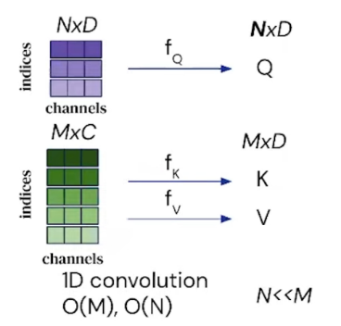
WikiText-103: Masked Language Model Pre-training
Goal — pre-train a general language encoder without specialized tokenizers.
Component | Detail
Tokenization | Byte-level (UTF-8)
Vocabulary size | 256
Sequence length | 1024
Mask probability | 15%
Model | Perceiver IO (∼10M)
Epochs / batch | 50 / 32
Masked byte acc. | 82.20%
Why byte-level?
• No BPE / WordPiece tokenizer needed • Truly language-agnostic input • Fixed vocabulary of size 256 • Trade-off: longer sequences for the same text
MLM task
• 15% of byte positions masked • Output queries = masked positions • Decoder predicts original byte values • Cross-entropy loss over 256 classes
F. Gigli C. Vignoli Perceiver & Perceiver IO

Slide 28
GLUE: Fine-tuning on 8 Tasks
8 GLUE benchmark tasks
Fine-tuning setup
• Transfer the pre-trained MLM encoder • Replace output queries with a classification query • 30 epochs, LR = 5 × 10⁻⁴ • Byte-level input (same as pre-training)
Single sentence
CoLA · SST-2
Similarity
MRPC · STS-B · QQP
Inference
MNLI · QNLI · RTE
Each task tests a different NLU capability — with the same architecture.
F. Gigli C. Vignoli Perceiver & Perceiver IO

Slide 29
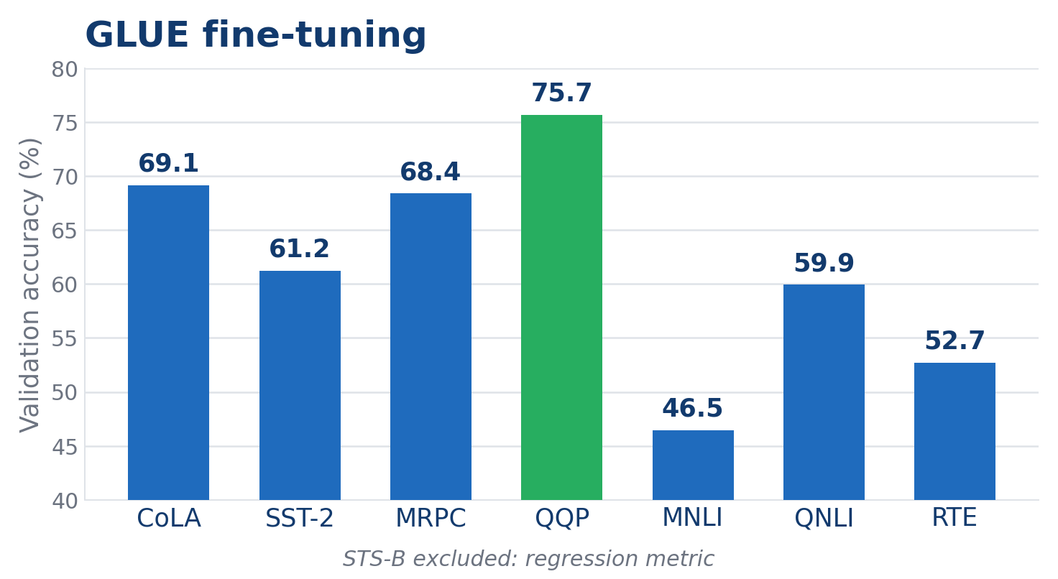
GLUE: Per-Task Results
Per-task pattern
QQP is the strongest task at 75.65%, while inference tasks (MNLI, RTE) are hardest. The classification mean sits around 62% with a much smaller, tokenizer-free model.
Setup factors
• Byte-level input, no subword tokenizer • Smaller model: ∼10M vs 201M • STS-B excluded (regression metric) • CoLA acc. ≈ majority baseline (official metric is MCC)
F. Gigli C. Vignoli Perceiver & Perceiver IO

Slide 30
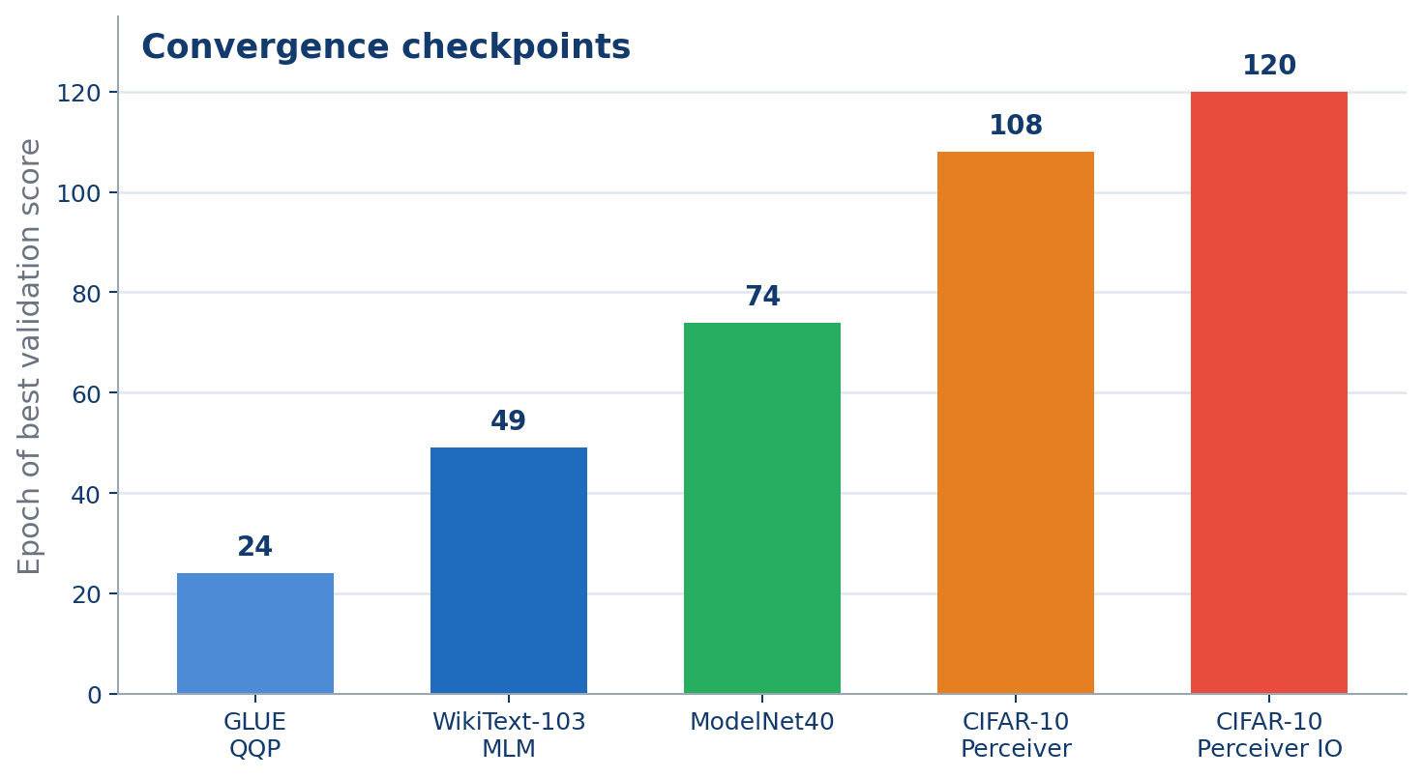
Convergence: Representative Checkpoints
Run | Best epoch
GLUE QQP | 24
WikiText-103 MLM | 49
ModelNet40 | 74
CIFAR-10 Perceiver | 108
CIFAR-10 Perceiver IO | 120
Pattern
• Fine-tuning peaks earlier than image training • Point clouds converge before CIFAR-10 • CIFAR-10 requires the longest schedule
F. Gigli C. Vignoli Perceiver & Perceiver IO

Slide 31
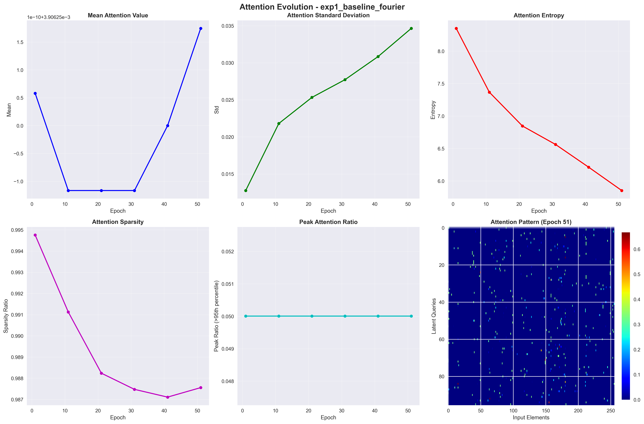
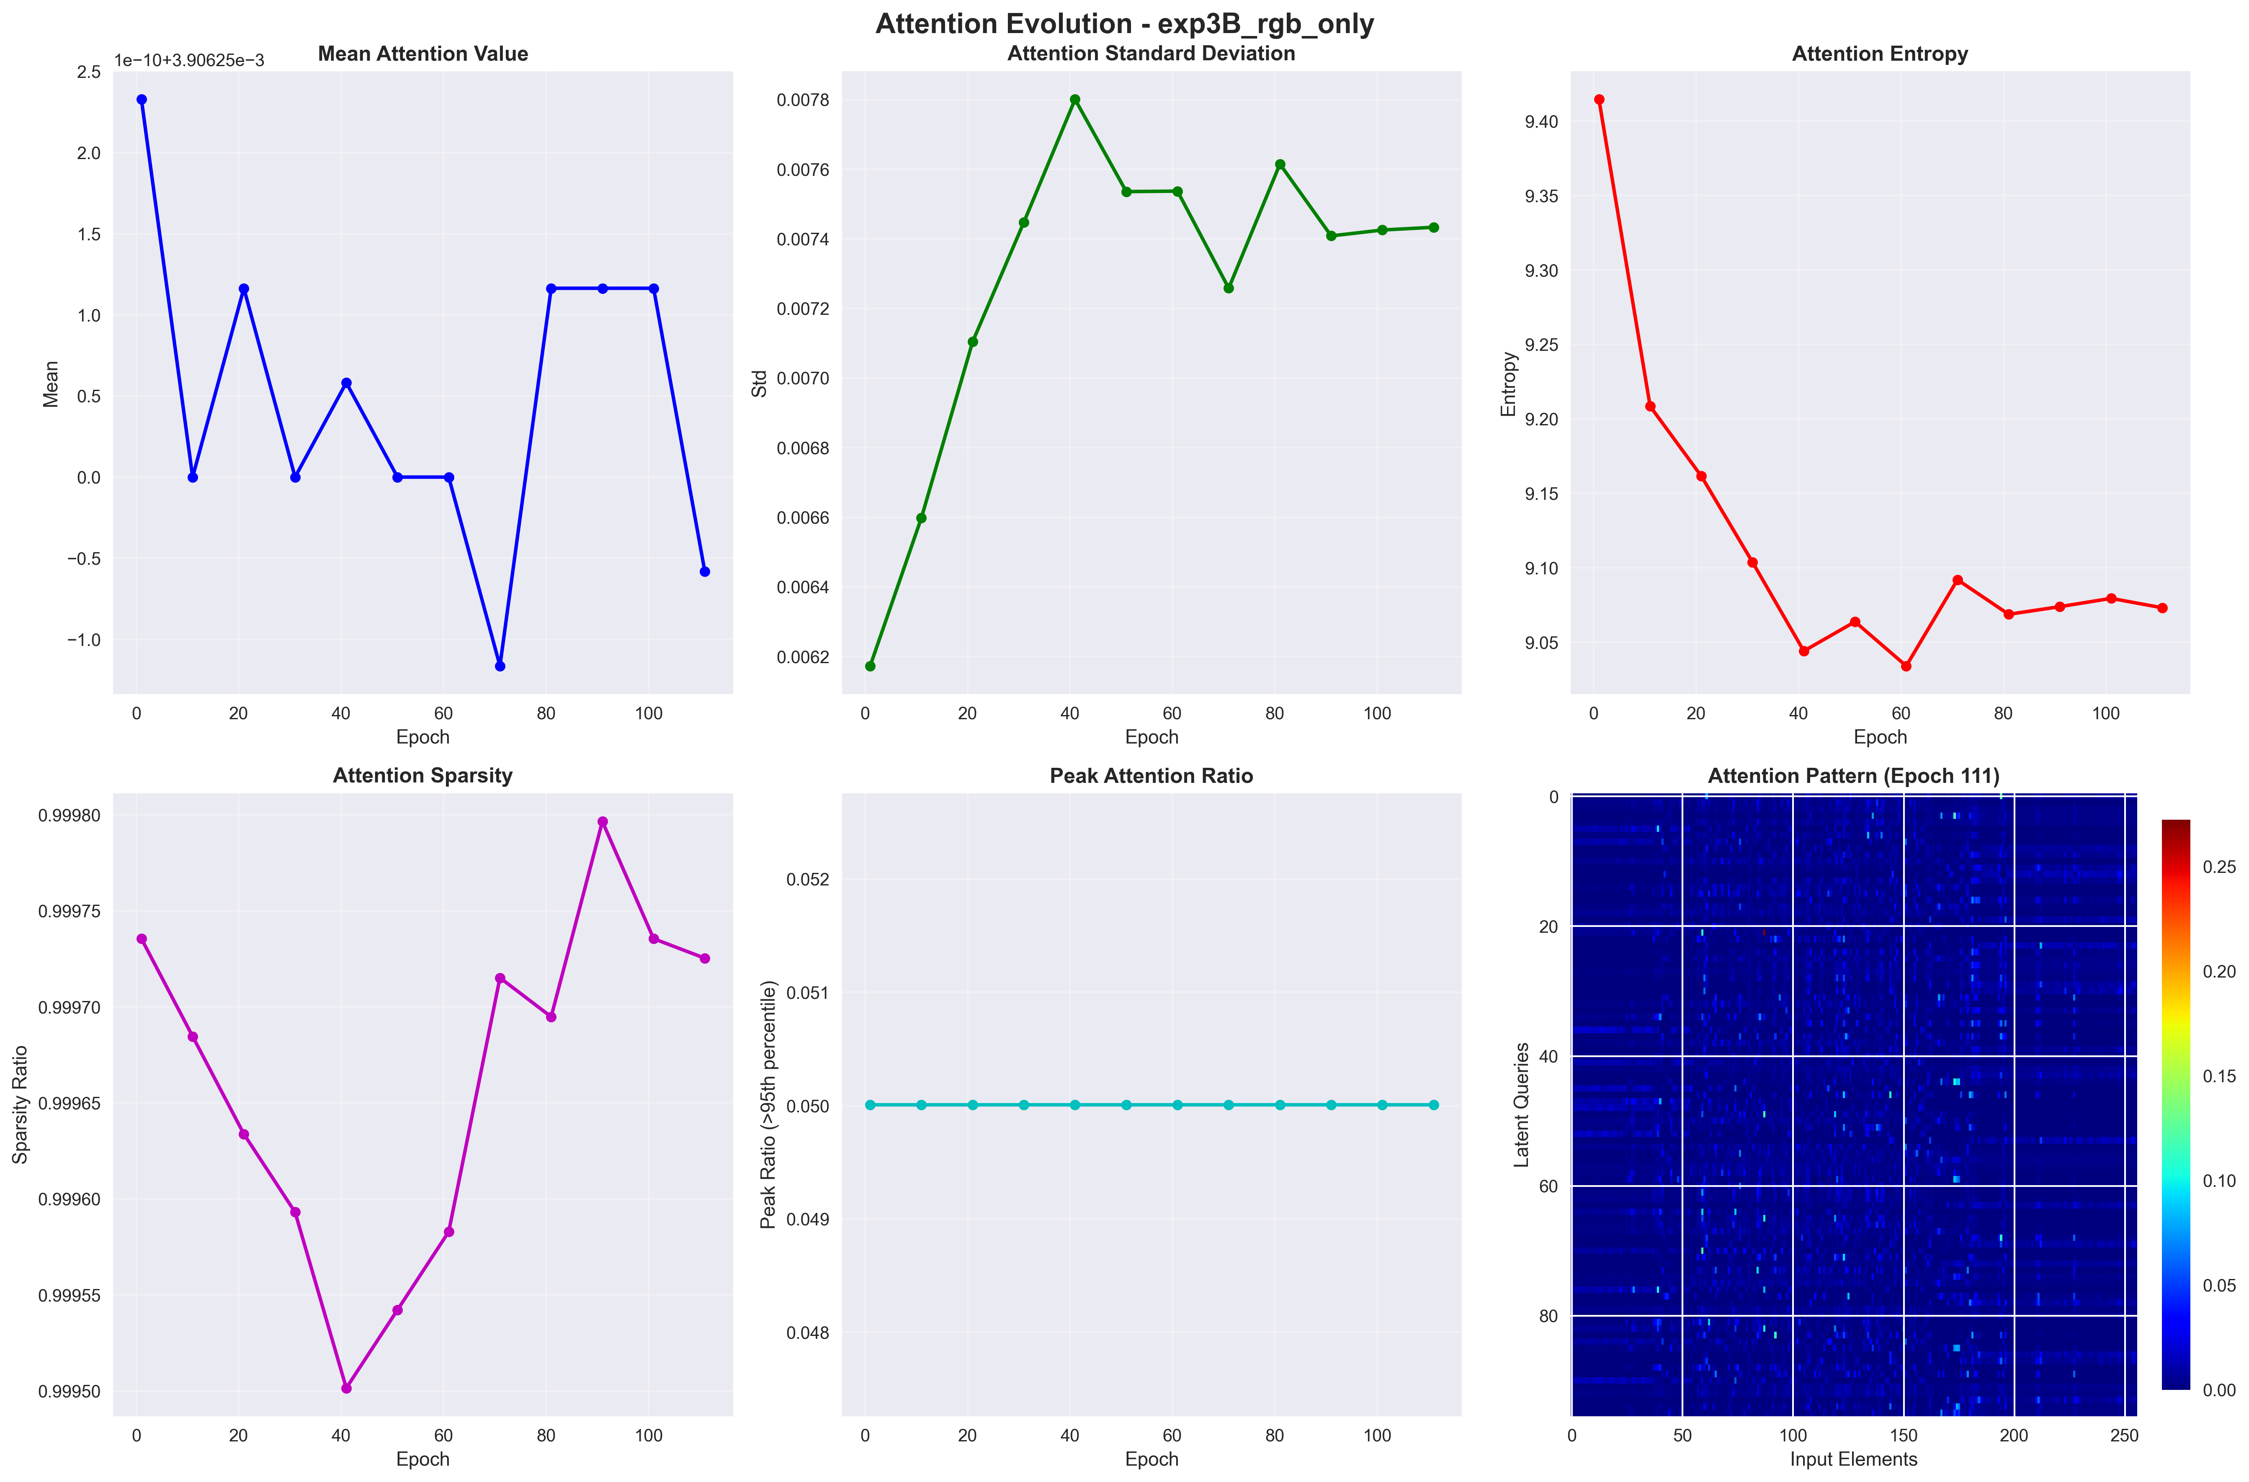
Attention Maps Analysis
Fourier PE (baseline, final maps)
RGB only — no PE (final maps)
Structured, spatially selective patterns. Latents specialize in different image regions.
Diffuse, near-uniform patterns. No spatial selectivity — the model cannot localize information.
Interpretation With Fourier PE, cross-attention learns spatially coherent patterns; without PE, entropy stays high and patterns lack structure.
F. Gigli C. Vignoli Perceiver & Perceiver IO

Slide 32
Comprehensive Results Summary
Modality | Model | Best Acc. | Reference | Experiments
Images (CIFAR-10) | Perceiver | 78.12% | > 90% † | 7 ablations
Images (CIFAR-10) | Perceiver IO | 78.20% | — | 1
Point Clouds (ModelNet40) | Perceiver | 84.24% | 85.7% | 3 augment.
Text (WikiText-103) | Perceiver IO | 82.20% MLM | — | 1
NLU (GLUE, 8 tasks) | Perceiver IO | ∼62% avg | — | 8 fine-tune
† Strong ViT/CNN baselines on CIFAR-10; the original Perceiver paper does not benchmark CIFAR-10.
∼2500
20+
3
100%
lines of PyTorch
training runs
modalities
reproducible
F. Gigli C. Vignoli Perceiver & Perceiver IO

Slide 33
Gap vs Original Papers
ModelNet40 — Point Clouds
CIFAR-10 — Images
Source | Acc.
Original Paper | 85.7%
This implementation | 84.24%
Gap | 1.46 pp
Source | Acc.
ViT / CNN baseline | > 90%
This Perceiver IO | 78.20%
Gap | ∼12 pp
Small reproduction gap — the main scale difference is batch size (128 vs 512).
Larger gap vs strong ViT/CNN baselines (the Perceiver paper has no CIFAR-10); TPU cluster vs single GPU.
The CIFAR-10 gap is mainly batch size (64 vs 1024), latent count (96 vs 256) and compute limits — the architecture is especially scale-sensitive on images.
F. Gigli C. Vignoli Perceiver & Perceiver IO

Slide 34
Hardware Limitations & Design Choices
Parameter | Original Paper (Google) | Project Setup
Hardware | 512 TPU v3 cores | 1 NVIDIA consumer GPU
Batch size | up to 1024 | max 64–128
Latents (N) | 256–512 | 96–128
Model size | 30–100M+ params | 3.35–10M params
Training time | days (distributed) | hours–days (single GPU)
Consequences
Mitigation strategies
• LAMB less effective with small batches • Fewer latents limit representational capacity • Reduced augmentation due to time constraints • Fewer hyperparameter-search iterations
• Weight sharing to reduce memory • Gradient accumulation where possible • Careful cosine-annealing schedule • Focus on the most informative ablations
F. Gigli C. Vignoli Perceiver & Perceiver IO

Slide 35
Possible Improvements
Architecture
Training
• Increase latent count (N = 256+) with gradient checkpointing • Multi-scale cross-attention (coarse → fine) • Relative positional encodings (RoPE, ALiBi) • Deeper decoder for structured outputs
• Larger batches via gradient accumulation • Mixed-precision (FP16 / BF16) training • Longer training schedules • Advanced augmentation (CutMix, MixUp)
Data & Tasks
Analysis
• ImageNet pre-training for vision • Subword tokenization for NLP • Multi-modal joint training • Audio modality experiments
• Layer-wise attention probing • Latent-space clustering visualization • Systematic hyperparameter search • Compare with efficient Transformers (Linformer, Performer)
F. Gigli C. Vignoli Perceiver & Perceiver IO

Slide 36
Empirical Summary
Observed strengths
Observed limitations
• Modality-agnostic architecture • Weight sharing: ∼2.6× fewer parameters, modest accuracy cost • Perceiver IO slightly edges base Perceiver on CIFAR-10 • MLM pre-training transfers to GLUE fine-tuning • Fourier PE is robust and general-purpose
• Performance gap vs paper on images (∼12 pp) • LAMB optimizer sensitive to batch size • Byte-level tokenization → very long sequences for text • Augmentation can hurt with limited training • Hyperparameter tuning is time-consuming
Central finding — positional encoding is the largest single factor in the CIFAR-10 ablation: removing it drops accuracy from 72.02% to 61.34%.
F. Gigli C. Vignoli Perceiver & Perceiver IO

Slide 37
Conclusions
Architecture properties
Remaining limitations
• Single architecture for images, point clouds, and text • Linear complexity in input size • Memory efficiency via weight sharing (∼61%) • Zero CNN / RNN domain-specific assumptions • Output queries enable flexible structured decoding
• Requires large compute to match specialized models • Heavily depends on positional encoding • Outperformed by efficient CNNs on vision benchmarks • LAMB introduces training instability at small scale • Latent bottleneck limits fine-grained spatial reasoning
A single general-purpose architecture applies to images, point clouds, and text. At the tested scale, performance depends strongly on positional encoding, latent capacity, and available compute.
F. Gigli C. Vignoli Perceiver & Perceiver IO

Slide 38
Thank you!
Questions?
Francesco Gigli · Corso Vignoli
Università degli Studi di Firenze · Course B031278 — Deep Learning
Code and models available upon request

